Slide 1

Exploratory Data Analysis of British Airways Customer Reviews

Slide 2

Introduction
The task at hand involves scraping customer reviews from the Skytrax website, specifically focusing on feedback related to airlines. The primary goal is to collect and analyze as much review data as possible to uncover valuable insights into the passenger experience. The data scraping process will be initiated using Python, particularly in a Jupyter Notebook environment, to ensure smooth collection and processing of large datasets.
Once the reviews are collected, the data will need to be cleaned and pre-processed to address common issues such as missing values, irrelevant information, and formatting inconsistencies. Data cleaning will be essential for preparing the dataset for further analysis.
After cleaning the data, we will explore various analysis techniques, such as topic modeling, sentiment analysis, and word clouds, to gain insights into customer sentiment and identify recurring themes in the reviews. These techniques will help us understand passenger preferences, pain points, and overall satisfaction with the airline. The goal is to uncover actionable insights that can help improve the airline's services and enhance the passenger experience.

Slide 3
Extracted Data
Below are the columns where the data was extracted from the web.
Aircraft | Type Of Traveller | Seat Type | Route | Date Flown | Seat Comfort | Cabin Staff Service | Ground Service | Value For Money | Recommended | Food & Beverages | Inflight Entertainment | Wifi & Connectivity | Reviews
A321 | Family Leisure | Economy Class | London to Belfast | November 2024 | 3 | 2 | 5 | 5 | no |  |  |  | ✅ Trip Verified | Although like many t………
A350 | Couple Leisure | Business Class | Vancouver to London | November 2024 | 5 | 5 | 3 | 4 | yes | 5 | 4 | 4 | ✅ Trip Verified | This flight was Brit……..
 | Solo Leisure | Economy Class | Malaga to London | October 2024 | 1 | 1 | 1 | 2 | no | 1 | 1 | 1 | Not Verified | The worst airline ……
A350 | Solo Leisure | Economy Class | Keflavik to Cape Town via London | October 2024 | 2 | 2 | 1 | 2 | no | 1 |  |  | ✅ Trip Verified | Disappointing service, plane interior and terribly…………
 | Couple Leisure | Economy Class | Singapore to Keflavik via London | October 2024 | 2 | 2 | 1 | 3 | no | 1 | 2 | 1 | ✅ Trip Verified | A transit visa is requi…………

Slide 4
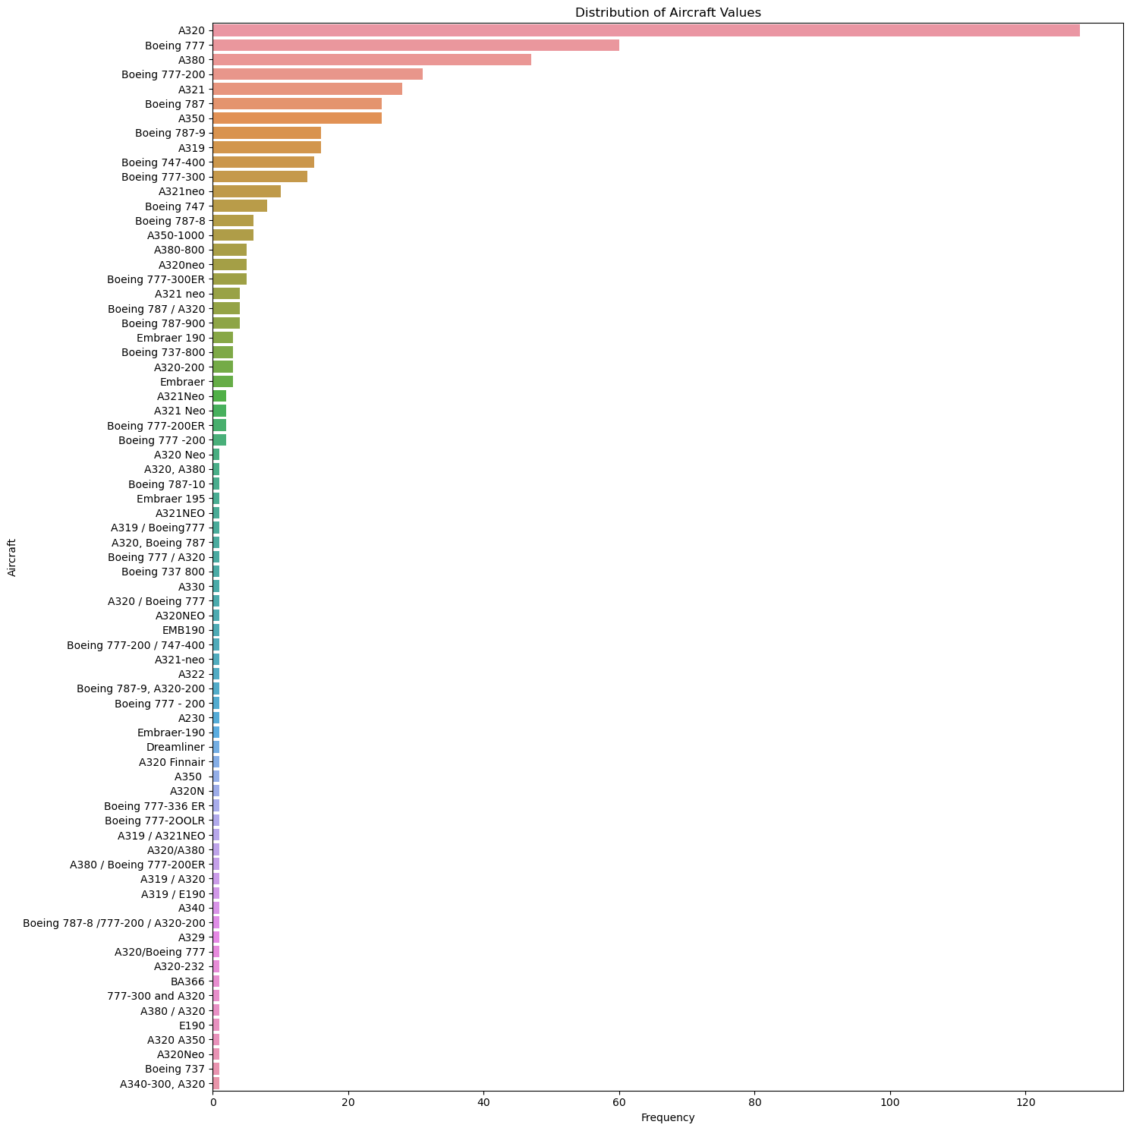
Distribution According to aircrafts

Slide 5
Distribution According to aircrafts
Overall Observations
A320 Dominance: The A320 family of aircraft (A320, A320neo, A321neo, etc.) appears to have the highest frequency, indicating it's the most common type of aircraft in this dataset.
Boeing 777 and 787 Presence: Boeing's 777 and 787 models are also quite prevalent, suggesting a strong presence of these long-haul aircraft.
Embraer 190 and 195: The Embraer 190 and 195 models have a notable frequency, likely representing regional or smaller aircraft.
Specific Insights
A320 Variants: The A320 family has a diverse range of variants, with the A320 and A321neo being the most common. This highlights the versatility of this aircraft family for various flight ranges and passenger capacities.
Boeing 777 Variants: The Boeing 777 family also includes several variants (777-200, 777-300, etc.), indicating a preference for this aircraft type in different configurations.
Boeing 787 Variants: The 787 Dreamliner family (787-8, 787-9, etc.) is also well-represented, suggesting its popularity for long-haul flights.
Embraer Regional Jets: The Embraer 190 and 195 are likely used for regional or short-haul flights, given their smaller size and capacity.
Possible Interpretations
Airline Preferences: The distribution could reflect the preferences of airlines operating these aircraft, with some airlines favoring specific models or families.
Route Network and Market Demand: The type of aircraft used might be influenced by the airline's route network and the demand for different types of flights (short-haul, long-haul, regional).
Aircraft Age and Replacement Cycles: The distribution could also be affected by the age of the aircraft and the timing of replacement cycles.

Slide 6
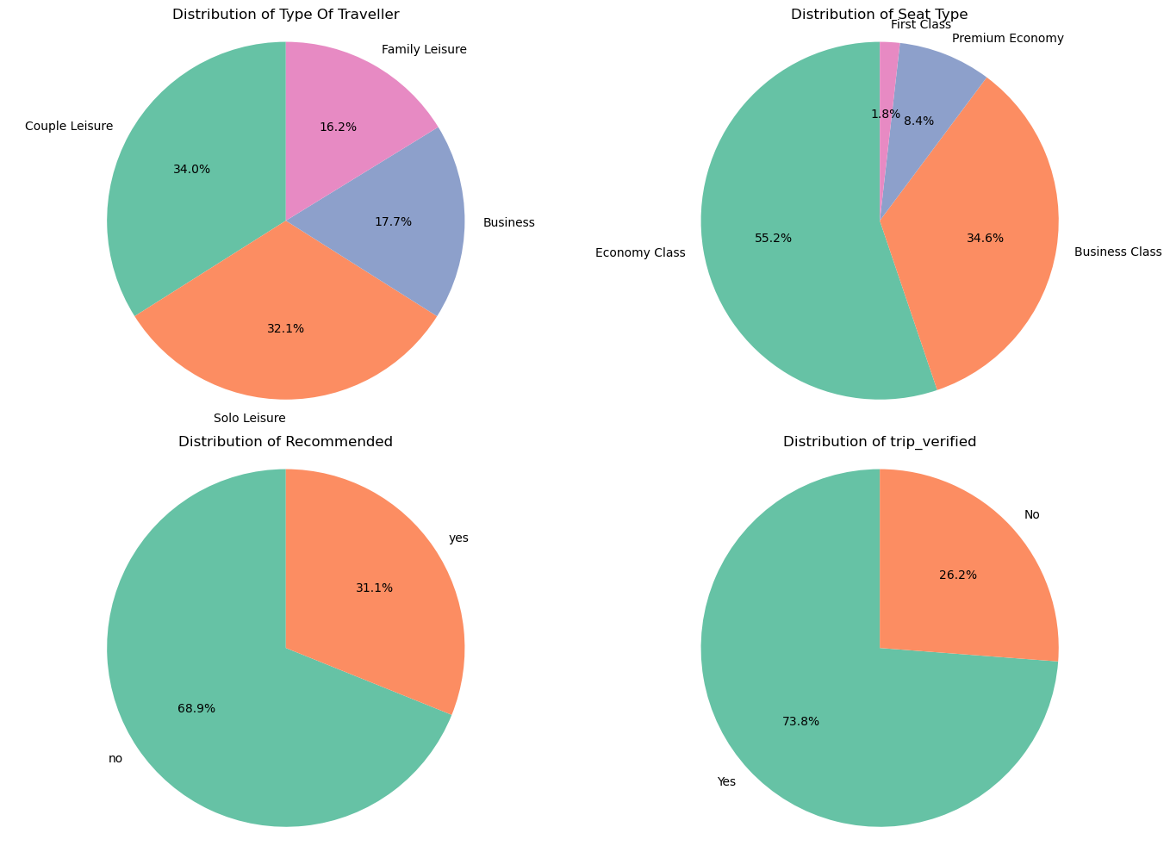
Distribution of type of travelers, seat type, recommendation, and trip verification

Slide 7
Distribution of type of travelers, seat type, recommendation, and trip verification
Distribution of Type of Traveler
Couple Leisure: This category is the most dominant, accounting for 34.0% of the data.
Solo Leisure: Takes up 32.1% of the data.
Family Leisure: Represents 16.2% of the data.
Business: Makes up 17.7% of the data.
Distribution of trip verification
Yes: 73.8% of the trips have been verified.
No: 26.2% of the trips have not been verified.
Distribution of
Seat Type
Economy Class: The majority of travelers choose Economy Class, with 55.2% of the data falling into this category.
Business Class: Accounts for 34.6% of the data.
Premium Economy: Makes up 8.4% of the data.
First Class: Is the least popular, with only 1.8% of the data falling into this category.
Distribution of Recommended
Yes: 68.9% of the travelers have received recommendations.
No: 31.1% of the travelers have not received recommendations.

Slide 8
Distribution of type of travelers, seat type, recommendation, and trip verification
Overall Observations
The graphs seem to be related to travel data, likely from an airline or travel agency.
They show the distribution of different categories like traveler type, seat type, recommendations, and trip verification.
Possible Insights
The data suggests that leisure travel is more popular than business travel.
Economy Class is the most preferred seating option, likely due to cost considerations.
A significant portion of travelers receive recommendations, indicating that recommendation systems might be effective in influencing travel choices.
Most of the trips are verified, which could be due to the airline's verification process or user behavior.

Slide 9
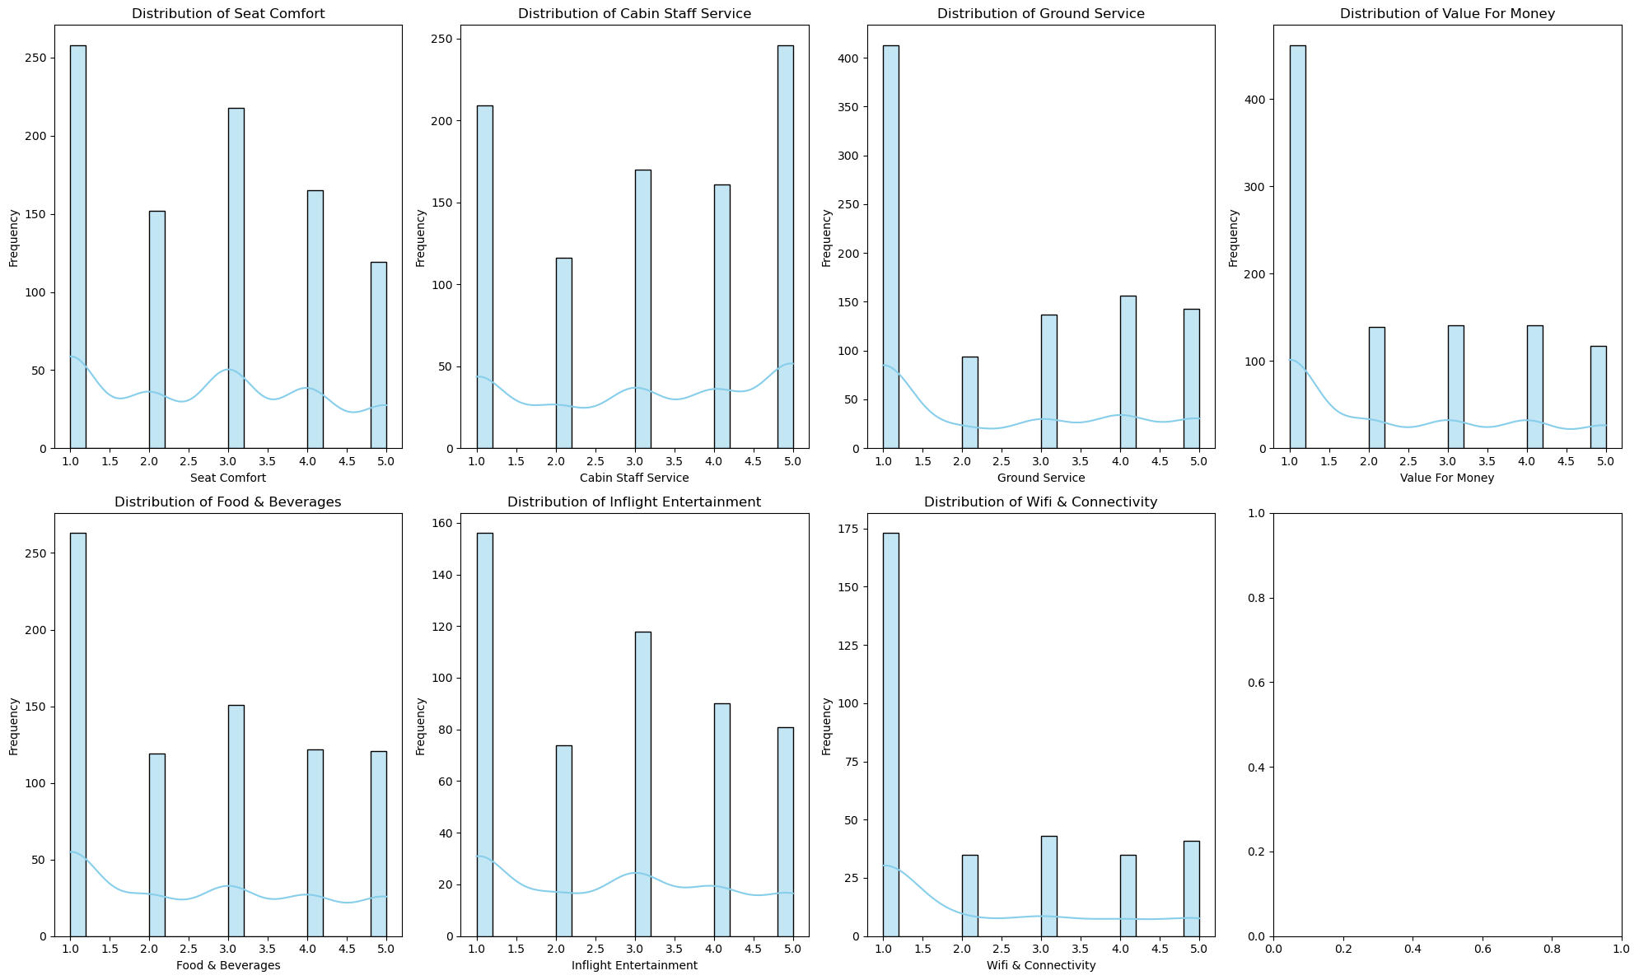
Analysing numerical columns

Slide 10
Analysing numerical columns
Seat Comfort:
Majority of ratings fall between 3.0 and 4.0, indicating moderate to good comfort.
Smaller peak around 2.0, indicating some dissatisfaction.
Cabin Staff Service:
Skewed towards higher ratings, with a peak around 4.5, suggesting excellent service.
Minimal dissatisfaction, with fewer ratings below 3.0.
Ground Service:
Similar to cabin staff service, with a peak around 4.5, suggesting excellent service.
Minimal dissatisfaction, with fewer ratings below 3.0.
Value for Money:
More varied opinions, with peaks around 3.0 and 4.0.
Some dissatisfaction indicated by ratings below 3.0.
Food & Beverages:
Similar to value for money, with peaks around 3.0 and 4.0, suggesting varied opinions.
Some dissatisfaction indicated by ratings below 3.0.
In-flight Entertainment:
Skewed towards higher ratings, with a peak around 4.5, suggesting excellent quality.
Minimal dissatisfaction, with fewer ratings below 3.0.
Wi-Fi & Connectivity:
Skewed towards lower ratings, with a peak around 2.5, indicating poor or average perception.
Minimal satisfaction with ratings above 4.0.

Slide 11
Analysing numerical columns
Overall Observations
The graphs appear to represent customer ratings for various aspects of an airline service, likely collected through surveys or feedback forms. The ratings range from 1 to 5, with higher ratings indicating better satisfaction.
Possible Insights
The airline generally performs well in terms of cabin staff service, ground service, and in-flight entertainment.Seat comfort and value for money seem to be areas where the airline could improve.Wi-Fi and connectivity are major areas of concern for passengers.

Slide 12
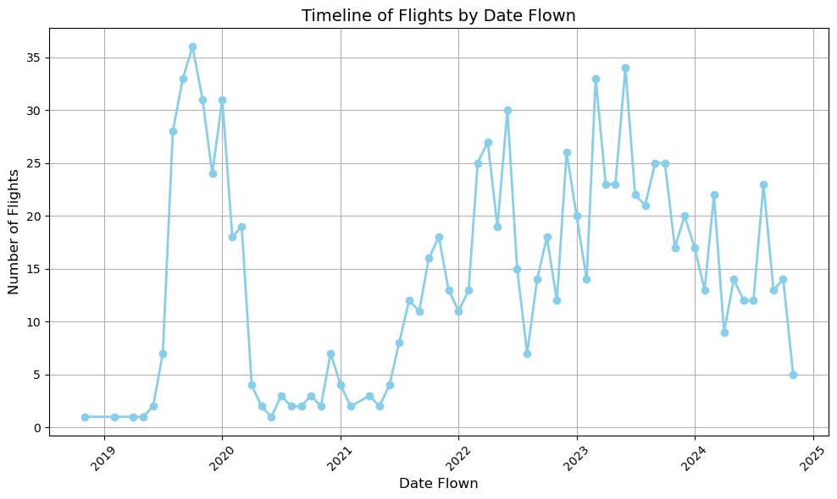
Distribution Over the years

Slide 13
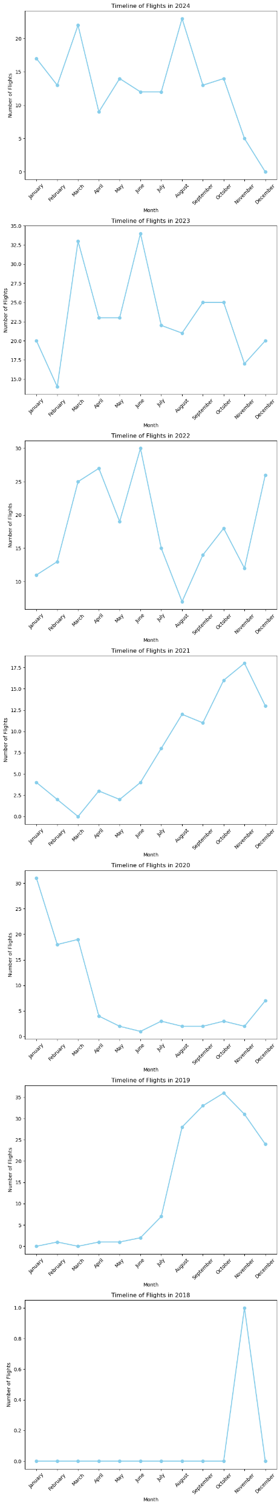
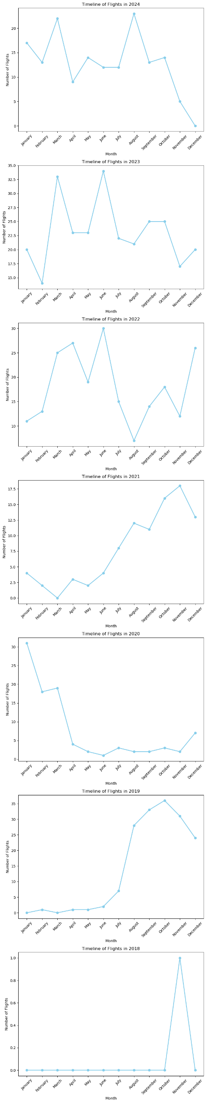
Distribution Over the years and months

Slide 14
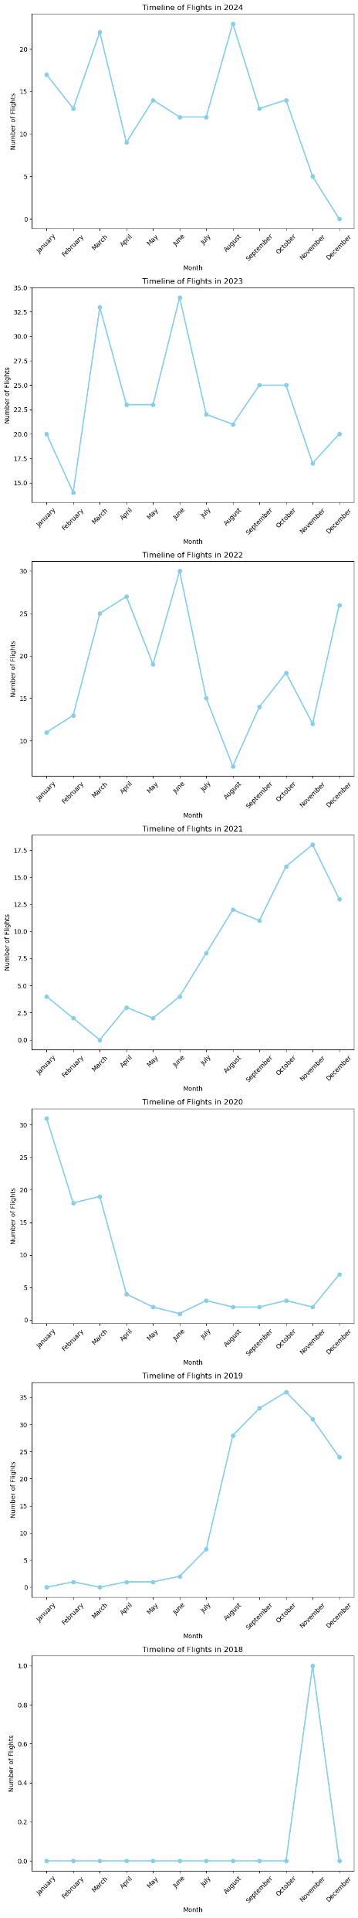
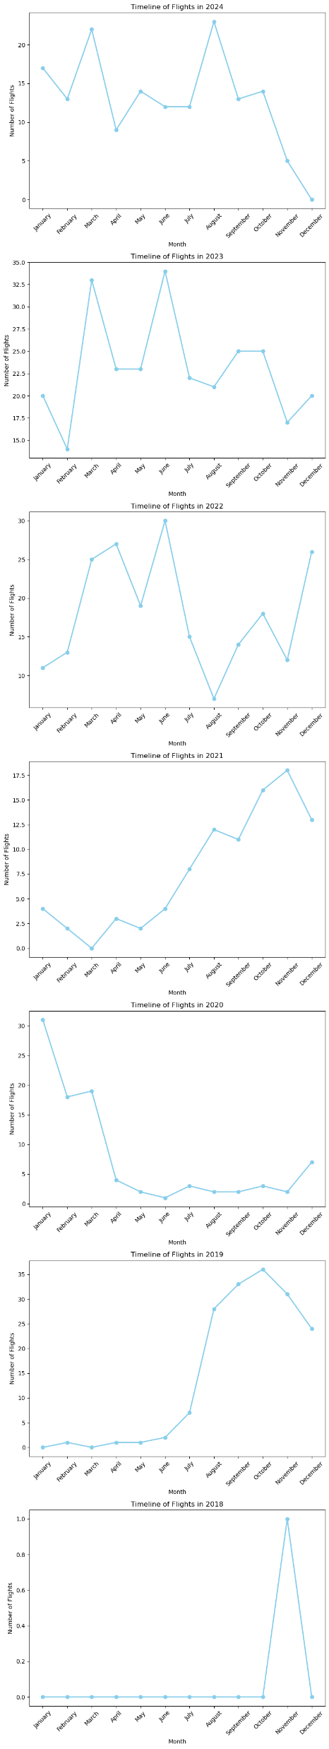
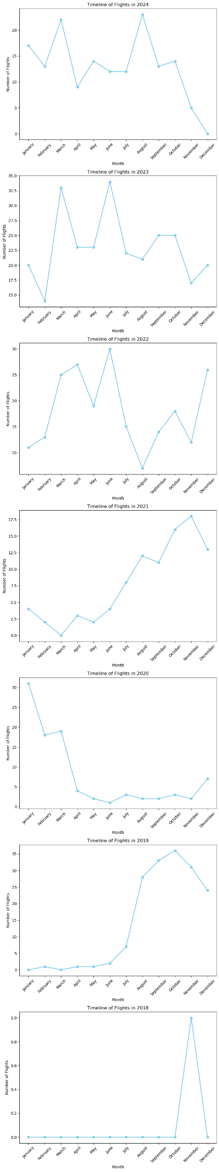
Distribution Over the years and months

Slide 15
Distribution Over the years and months
Overall Observations
The graphs appear to represent the number of flights over time for different years, likely from 2018 to 2024. The x-axis shows the months, while the y-axis represents the number of flights.
Individual Graph Interpretations
2024: The graph shows a general upward trend in the number of flights throughout the year, with peaks in certain months.
2023: The graph shows a similar pattern to 2024, with an upward trend and peaks in certain months.
2022: The graph shows a more consistent pattern, with the number of flights fluctuating around a certain level throughout the year.
2021: The graph shows a significant drop in the number of flights, likely due to the impact of the COVID-19 pandemic.
2020: The graph shows a similar pattern to 2021, with a significant drop in the number of flights.
2019: The graph shows a more consistent pattern, with the number of flights fluctuating around a certain level throughout the year.
2018: The graph shows a significant increase in the number of flights towards the end of the year.
Possible Insights
The graphs suggest that the aviation industry has been significantly impacted by the COVID-19 pandemic, with a sharp decline in the number of flights in 2020 and 2021.
The industry seems to be recovering in 2022 and 2023, with the number of flights gradually increasing.
The peaks and troughs in the graphs might be due to seasonal variations in travel demand or specific events.

Slide 16
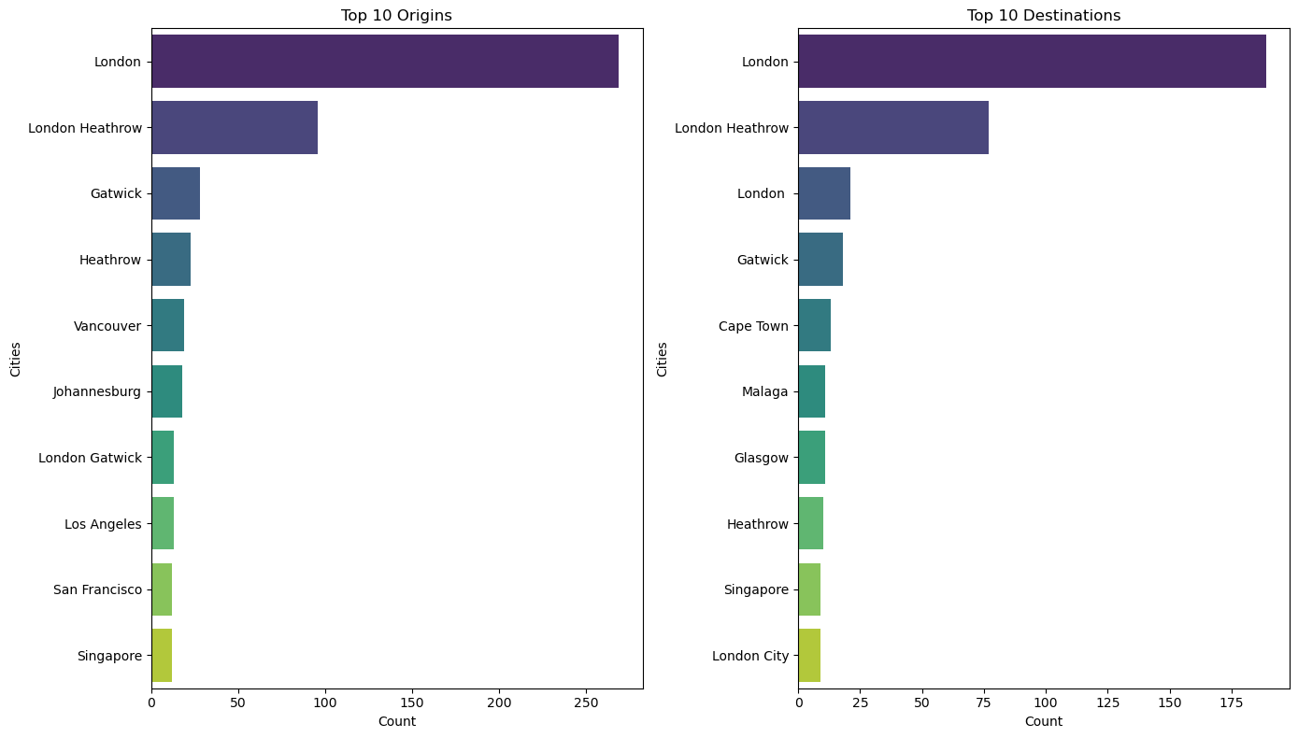
Top Origins and destinations

Slide 17
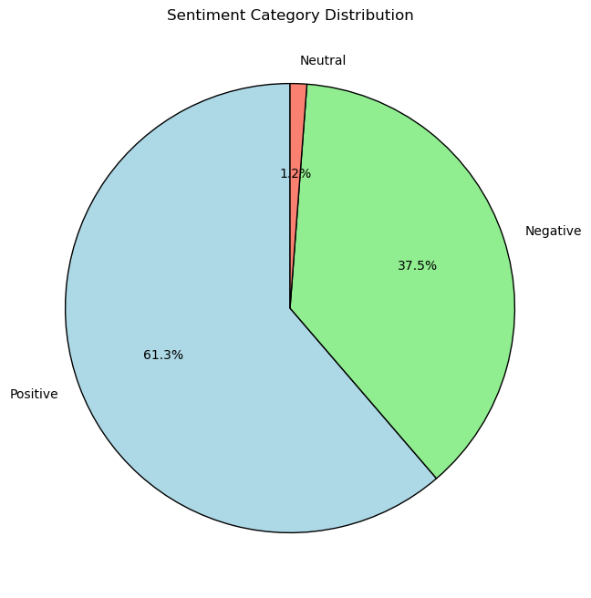
Sentimental Analysis

Slide 18
Sentimental Analysis
Overall Interpretation
The pie chart presents the distribution of sentiment categories (positive, negative, and neutral) within a dataset, likely derived from text analysis.
Specific Insights
Positive Sentiment Dominance: The most significant portion of the data (61.3%) falls under the positive sentiment category. This suggests that the overall sentiment of the analyzed text is predominantly positive.
Negative Sentiment Presence: While less prominent, the negative sentiment category accounts for 37.5% of the data. This indicates that there is a notable presence of negative sentiment within the text.
Neutral Sentiment Minority: The neutral sentiment category constitutes the smallest portion of the data, at 1.2%. This suggests that most of the text expresses either positive or negative opinions.

